Slide 1
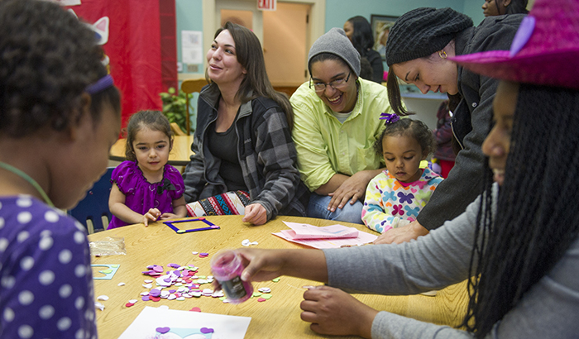
Family Engagement: What, Why, and How
Foundational Webinar – Part 1
Dr. Theresa Pfister & Terry Baker, M.Ed, LMFT-S
November 5th, 2024
Notes:
Hello everyone! My name is Dr. Theresa Pfister and I am really thrilled to be here today and tomorrow to talk with you about family engagement – what it is, why it’s so important, and how we do it. Today, I am joined by Terry Baker, who is bringing his experience and expertise and will help ground us in the work.

Slide 2
Acknowledgement/Disclaimer
This project is supported by Grant #15PJDP-22-GK-03889-STOP awarded by the Office of Juvenile Justice and Delinquency Prevention (OJJDP), Office of Justice Programs, U.S. Department of Justice. The opinions, findings, and conclusions or recommendations expressed in this publication/program/exhibition are those of the author(s) and do not necessarily reflect those of the Department of Justice.
Notes:
As always, we want to share this quick disclaimer that the opinions and recommendations expressed in this two-part series are ours and do not necessarily reflect those of the department of justice.

Slide 3
Notes:
If you recognize this slide, you’ve probably already heard my introduction but for those of you who are new, I’ll run through a quick intro to myself and my background.
I am originally from a small town in rural Wisconsin. I was a QuestBridge scholar at Pomona College in California. I earned my degree in English Literature but spent a lot of time in the politics and philosophy departments as well. After graduating, I joined the Peace Corps in Ethiopia and then moved to New York City. I started teaching at an elementary school in Brooklyn and then moved into the non-profit sector, where I got to work closely with high school students from across the city. From there, I moved south to earn my PhD in educational psychology from the University of Virginia. Now, I live in Baltimore and work at WestEd in the Resilient and Healthy Schools and Communities content area, where I do a mix of research and technical assistance across topics such as trauma-informed schools, social-emotional learning, school climate, and school-based mental health.

Slide 4
Terry Baker, M.Ed., LMFT-S
Terry is a Clinical Mental Health Counselor for the Thrive Center at Nelson County Schools.
Notes:
Terry introduces himself!

Slide 5
What was family engagement like in your K-12 experience? How does that impact your approach today?
Notes:
My hope for today and tomorrow’s sessions is that we’re really engaged and connected and learning from one another. Terry and I have our own knowledge, but you and your peers have so much as well. One key way through which you can engage is through the chat – which I invite at all times. I’ll specifically ask you to put things in the chat, but you can also add in reactions and thoughts and questions throughout the webinar. The other way to engage is through the raise hand function. It’s a bit awkward and always takes me a minute to find, so I’d actually love for everyone to practice finding the button and raising their hands. For me, it’s under the “reactions” button – you’ll see “raise hand.” Can I ask everyone to find it and click it?
Amazing! Thank you all! So, let’s practice for real this time with a prompt.
I’d like to ask you to think back to your years as a student in elementary, middle, and high school – what was family engagement like? Was it present? What opportunities were there? What did it feel like? And secondly, how does that impact your approach today?
Feel free to spend the next two to three minutes minutes jotting down your thoughts – you can put them in the chat if you’re comfortable sharing.
Okay, we’ll start this reflection by asking Terry – Terry, can you tell us a little about what family engagement was like during your K-12 experience and how that impacts your approach today?
Excellent. I’d love to open it up to all grantees. What was your family engagement experience like in K-12 and how does that impact your approach today? You can use the raise hand feature!

Slide 6
Our Goals:
Part 1: Today, 11/5
Define family engagement
Explore the benefits of family engagement
Part 2: Tomorrow, 11/6 at 12 pm EST
We will explore how schools can support family engagement
Use the Plan-Do-Study-Act framework to promote family engagement
Notes:
Let’s take a moment to look at our goals for our time together today and tomorrow.
Today, we’re going to start by defining family engagement and then spend some time exploring its plethora of benefits. We’ll spend the second half of the session starting to work with the Plan Do Study Act framework to promote family engagement.
Tomorrow, we’ll learn about a ton of strategies for promoting family engagement and continue working through the Plan-Do-Study-Act framework and use that to improve our own practices.

Slide 7
What is family engagement?
Family engagement is a shared responsibility of families, educators, and community partners to support children and youth’s learning, development, wellbeing, and success.
Global Family Research Project, n.d.; Woolf, n.d.
Notes:
To get us all on the same page, I want to start with a definition of family engagement. Perhaps unsurprisingly, there are lots of definitions out there, so I read a bunch of them and put together this one together: Family engagement is a shared responsibility of families, educators, and community partners to support children and youth’s learning, development, wellbeing, and success.
There are a few components of family engagement that I want to highlight:
https://globalfrp.org/Our-Work/Family-Engagement
https://www.panoramaed.com/blog/family-engagement-comprehensive-guide

Slide 8
What is family engagement?
The term “family” is inclusive and embraces all caregivers.
This includes but is not limited to:
biological, adoptive, and foster parents;
grandparents;
legal guardians and informal guardians;
aunts and uncles; and
adult siblings.
Global Family Research Project, n.d.; Woolf, n.d.
Notes:
First, when we use the term “family,” we are using it inclusively and embracing all caregivers. That includes but is not limited to:
biological, adoptive, and foster parents;
grandparents;
legal guardians and informal guardians;
aunts and uncles; and
adult siblings.

Slide 9
What is family engagement?
Family engagement is holistic.
This includes the whole child or youth: their social, emotional, cognitive, academic, physical, and mental health.
Learning Policy Institute, n.d.
Notes:
Secondly, when we speak about the goals of family engagement, it’s not just to ensure our kids get As in school. We’re focused on the whole person in a holistic way. That includes their social, emotional, cognitive, academic, physical, and mental health.
https://learningpolicyinstitute.org/topic/whole-child-education

Slide 10
What is family engagement?
Family engagement is collaborative.
Families, educators, and community partners work together to create a network of support for the child or youth.
Global Family Research Project, n.d.; Woolf, n.d.
Notes:
Finally, family engagement is collaborative. It means that families, educators, and community partners share responsibility to create a network of support for children and youth.

Slide 11
What is family engagement?
Family engagement is a shared responsibility of families, educators, and community partners to support children and youth’s learning, development, wellbeing, and success.
Global Family Research Project, n.d.; Woolf, n.d.
Notes:
Now, before we move on, I’d love to hear from you – what is your response to this definition? What would you add, change, or even remove?
You can put your responses in the chat or use the raise hand function.
Terry, any final thoughts? Is there anything you would add, change, or remove?
https://globalfrp.org/Our-Work/Family-Engagement
https://www.panoramaed.com/blog/family-engagement-comprehensive-guide

Slide 12
What are the benefits of family engagement?
Research shows that family engagement is closely linked to
better attendance,
higher academic achievement,
greater likelihood of graduation,
improved social and emotional development, and
more positive school climate.
Henderson & Mapp, 2002, Henderson et al., 2007; Woolf, n.d.
Notes:
Now that we have a shared understanding of what family engagement is, I’d like to briefly cover the benefits of strong family engagement. Research shows that family engagement is closely linked to better attendance, higher academic achievement, greater likelihood of graduation, improved social and emotional development, and more positive school climate.
Excellent. So these are very school-focused benefits, but we also see benefits in violence reduction.
https://files.eric.ed.gov/fulltext/ED536946.pdf
Beyond the Bake Sale (book)

Slide 13
What are the benefits of family engagement?
Family engagement can help reduce school violence via
information sharing between families and staff,
issue spotting, and
the proactive development of timely interventions and supports.
Brubaker et al., 2001; Song et al., 2017
Notes:
Family engagement can help reduce school violence through these and other avenues:
information sharing between families and staff,
issue spotting, and
the proactive development of timely interventions and supports.
When I think about my own work, I saw further benefits – I saw a deeper, more connected community, I saw resource and support sharing, I saw trust develop that made a huge difference when hard things happened. How about you, Terry? What benefits of family engagement have you seen in your work?
I’d love to open it up to everyone – again, you can use the chat or the raise hand feature. Thinking about your own work, what other benefits of family engagement exist?
https://quod.lib.umich.edu/m/mfr/4919087.0006.101/--school-violence-partnerships-with-families-for-school-reform?rgn=main;view=fulltext
https://www.tandfonline.com/doi/abs/10.1080/15388220.2018.1512415

Slide 14
Family Engagement in Your Context
Notes:
Now before we get into the how of family engagement, I’d like to pass the mic over to our colleagues X and X to share their experiences with family engagement.

Slide 15
Promoting Family Engagement with Continuous Improvement
Notes:
Now that we know the definition and benefits of family engagement, it’s time to talk about how we promote meaningful family engagement ourselves. Through the rest of today and then all of tomorrow’s session, we’ll be using a worksheet to apply the content to our own contexts and needs.
My goal is that you will walk out of this two-day session with a collection of tools, resources, ideas, and next steps for how to promote family engagement at your own site. This is kind of a practice run of the Plan-Do-Study-Act cycle that will prepare you to do the same at your own site!
I’m going to put the document in the chat. Please download your own copy – it’s a word doc so you’ll be able to open it up and get right into it!
https://docs.google.com/document/d/1Mal79YKeAia4adgBoFHAGmLR9kxOrd0YeuqxkmpnaKM/edit?usp=sharing
Okay, any issues accessing the doc?
Perfect. As we move through the content, I’ll cue you in when it’s time to fill out different sections of the worksheet. It’s important to remember that for the purposes of this webinar, we’re running through this process as a kind of parallel, solo activity. The hope is to introduce you to the process and approach, with the goal that you’ll feel comfortable going back to your sites and doing this with your team.
Awesome. Any questions before we dig into the Plan-Do-Study-Act portion of our sessions?

Slide 16
Continuous Improvement: Plan-Do-Study-Act Cycle
Plan
Do
Study
Act
CASEL, n.d.; Shakman et al., 2017
Notes:
Alright! So “continuous improvement” is a bit of a buzzword. I would love to know more about your comfort with continuous improvement. Can I get in the chat 1 – 5: 1 being I’ve never heard of continuous improvement before, 3 is I’ve heard of it and I could define it, and 5 being I’m a pro, we use continuous improvement all the time.
Amazing, thank you!
So, very briefly, continuous improvement is the process of analyzing and making incremental changes in order to improve quality of a practice. In our case, to improve family engagement. This can be a whole program or school approach – e.g., as a site, we’re trying to increase overall family engagement – or this can be individualized and tailored to individual children / youth who would benefit from stronger family engagement. This can be part of a personal support plan.
There are a few approaches to continuous improvement, but I particularly appreciate the Plan-Do-Study-Act cycle. This is the framework we’ll use today and tomorrow.
Phase 1, Plan, is a big step – it’s got many subcomponents to ensure we have goals and choose the strategy we're going to try. Phase 2, Do, is when we actually implement the practice we’ve identified. Phase 3, Study, ensures we are collecting data in order to inform Phase 4, Act, where we’ll make those incremental changes to ensure we’re moving towards our goal.
https://drc.casel.org/practice-continuous-improvement/plan-for-improvement/
https://books.google.com/books/about/Learning_to_Improve.html?id=CKZhDwAAQBAJ&printsec=frontcover&source=kp_read_button#v=onepage&q&f=false
https://www.edc.org/sites/default/files/uploads/primer_for_continuous_improvement.pdf

Slide 17
Phase 1: Plan Gather a diverse team.
School and district leadership
Teachers from multiple departments
Support staff
Mental health providers
Community partners
Families
Students
CASEL, n.d.; Shakman et al., 2017
Notes:
Alright, so let’s get started with Phase 1: Plan. The first step here is to gather a diverse team. On this slide, I’ve shared a list of who we typically recommend is included on your team. This can include, but is certainly not limited to school and district leadership, teachers from multiple departments and grade levels, support staff, mental health providers, community partners, families, and students. The goal is to create a group of individuals with their own expertise and experience to ensure you have representation and as few gaps as possible as you envision your goals and plans for family engagement.
Terry, when you think about gathering a powerful team to support family engagement, who do you include and why?
Fabulous. Alright everyone, it’s time to try out your worksheet. You’ll see a place near the top to start listing out the people you think would be valuable members of this team. I’ll give us all four to five minutes to begin that list. If you have any questions or issues, please send us a message on chat and we’ll help you out! When you're done, go ahead and give us a thumbs up in the chat.
If you're done, feel free to put a thumbs up in the chat.
Okay, I’m going to bring us back and keep us moving. Again, this was a solo exercise, but as I mentioned before, it’ll be critical to get others' perspectives on who should be involved, so this was really just a starting point.
https://drc.casel.org/practice-continuous-improvement/plan-for-improvement/
https://www.edc.org/sites/default/files/uploads/primer_for_continuous_improvement.pdf

Slide 18
Phase 1: Plan Develop your purpose and goals.
Why are you building this team and doing this work?
What do you hope to accomplish?
CASEL, n.d.; Shakman et al., 2017
Notes:
The next step is to develop your purpose and goals for your team. The two guiding questions you can use to do this are:
Why are you building this team and doing this work?
What do you hope to accomplish?
Now, Terry, I’d like to ask you these questions as well. When planning, how do you define your purpose and goals?
Right, so if it's a whole site approach, our purpose and goals are aimed more broadly, while if we're thinking about engaging a particular child and their family, it's going to be much more specific.
Alright everyone, it’s your turn now – just under where you started your team list, you can see these two questions listed. I’ll give us all a few minutes to reflect on our worksheets.
Okay, I would love, if anyone is open to sharing, to hear a little bit about the purpose and goals you’re thinking about so far. A quick way to share is literally copying and pasting what you have in your word doc, otherwise feel free to raise your hand!
Fabulous. Thank you!
https://drc.casel.org/practice-continuous-improvement/plan-for-improvement/
https://www.edc.org/sites/default/files/uploads/primer_for_continuous_improvement.pdf

Slide 19
Phase 1: Plan Identify barriers and facilitators.
What is getting in the way?
What is keeping our families from partnering with us?
What is keeping us from partnering with our families?
CASEL, n.d.; Shakman et al., 2017
Notes:
The next step is to identify barriers and facilitators to family engagement in your community. We’ll start with the barriers:
The first question is: What is keeping our families from partnering with us? In our trauma informed schools webinar, we discussed the common barriers, including busy schedules, lack of trust, language barriers, and much more. But it’s important to think also about the constraints and barriers on our end as providers. For that reason, I added the second question: what is preventing us from partnering with our families?
Terry, what are some of the most common barriers you’ve faced in your work with families?
Thank you! Now, we can all take a couple minutes in your worksheet (right where you left off) to answer these two questions and think about the barriers our families and we face.
Excellent. So again, for the purpose of sharing that knowledge, I’d love to ask if you could put some of the barriers you identified in the chat. This has the dual purpose of letting others know they’re not alone with these barriers, but also maybe naming something that someone else could add to their own list.
Thank you!
https://drc.casel.org/practice-continuous-improvement/plan-for-improvement/
https://www.edc.org/sites/default/files/uploads/primer_for_continuous_improvement.pdf

Slide 20
Phase 1: Plan Identify barriers and facilitators.
What’s working?
What have we already done?
What went well?
Who are our champions and connectors?
What resources do we have?
CASEL, n.d.; Shakman et al., 2017
Notes:
Now that we’ve thought about the barriers, I’d love to think about what is working: the facilitators.
In your community, what have you done already? What went well? Who are your people? Do you have champions, either staff or families who are invested in family engagement? Do you have connectors? People who seem to know everyone? Finally, what resources do you have?
Terry, can you tell us a little about the facilitators in your community?
Thank you! Everyone, I’ll give us a couple minutes to return to our own worksheets and fill in some facilitators. We’ll come back and share out.
Beautiful – please add some facilitators in the chat. I know there are a lot of barriers, and I personally would love to have a longer collective list of facilitators!
----
Amazing. Before we move one, I do want to plug again that we’re doing this kind of as an empathy exercise, but we recommend doing this within your teams and learning from your community. We recommend offering surveys, interviews, and other opportunities to gather more representative data from the staff and families in your context and the barriers and facilitators they experience. It’s critical to be thoughtful about engaging those who may be pushed to the margins. Best practices include offering translations in home languages, keeping any survey short and anonymous, leaning on your community connectors, and offering compensation if you can.
https://drc.casel.org/practice-continuous-improvement/plan-for-improvement/
https://www.edc.org/sites/default/files/uploads/primer_for_continuous_improvement.pdf

Slide 21
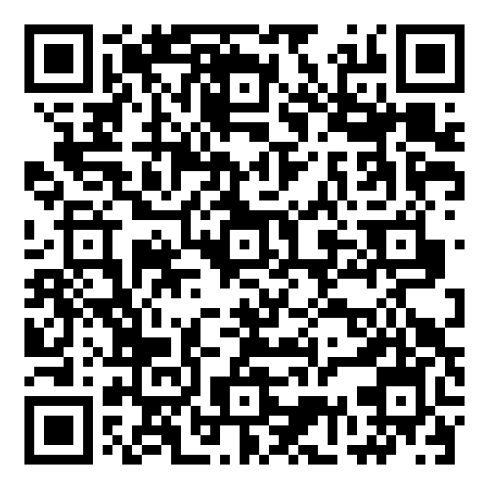
This free survey can help you measure families’ experiences and perceptions:
Family engagement
School fit
Support
School climate
Barriers to engagement
Roles and responsibilities
School safety
Panorama, n.d.
Notes:
While you can develop your own survey, interview, or focus group questions to learn more about barriers and facilitators, there is a free tool I wanted to share designed to assess family-school relationships from Panorama Education. It covers a bunch of different topics, including these listed above.
Family engagement
School fit
Support
School climate
Barriers to engagement
Roles and responsibilities
School safety
You can scan the QR code to take a look – I will also throw the link in the chat as well: https://panorama-www.s3.amazonaws.com/files/family-school-survey/User-Guide.pdf

Slide 22
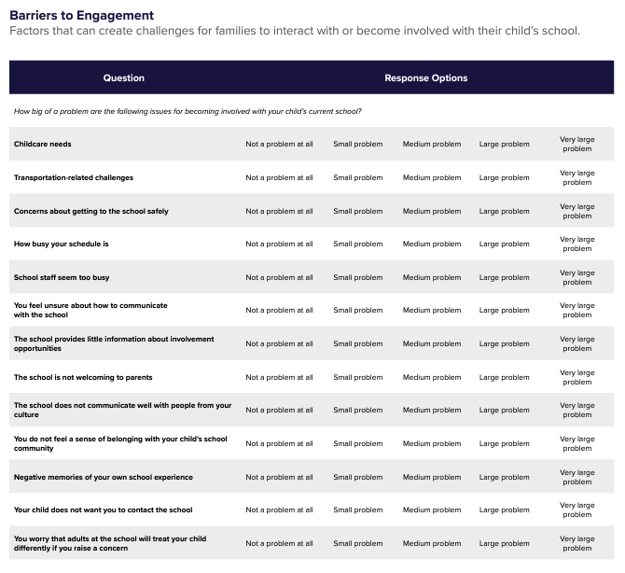
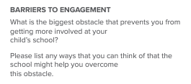
Panorama, n.d.
Notes:
Now, while this is designed for schools, their survey items are easily adapted to your site. These items are from their barriers to engagement section – on the right, there’s one big question with lots of examples:
How big of a problem are the following issues for becoming involved with your child’s current school? Then they list out things like childcare needs, transportation, busy schedules, etc.
On the left, there are two open-ended questions, that read:
What is the biggest obstacle that prevents you from getting more involved at your child’s school?
Please list any ways that you can think of that the school might help you overcome this obstacle.
So this is just a quick snapshot – I highly recommend digging into this resource a bit and see if it has anything you can use.
https://panorama-www.s3.amazonaws.com/files/family-school-survey/User-Guide.pdf

Slide 23
Phase 1: Plan Choose a barrier and practice to address it.
Choosing a barrier:
Which is most important?
Which is most urgent?
CASEL, n.d.; Shakman et al., 2017
Notes:
Okay, we’re still on phase 1, plan, but we’re almost to phase 2. Preparation is important!
The next step is to identify which of the barriers is your first priority. You’re trying to decide where to start. The two questions I find most helpful to identify our priorities is which is most important and which is most urgent?
https://drc.casel.org/practice-continuous-improvement/plan-for-improvement/
https://www.edc.org/sites/default/files/uploads/primer_for_continuous_improvement.pdf

Slide 24
Phase 1: Plan Choose a barrier and practice to address it.
Priority matrix:
 | Not Urgent | Urgent
Important | Important, not urgent | Important, urgent
Not Important | Not important, not urgent | Not important, urgent
CASEL, n.d.; Nevins, 2023; Shakman et al., 2017
Notes:
One way to visualize this is a priority matrix. Our columns are not urgent or urgent, and our rows are not important and important. This makes a helpful grid where we have four designations: important, not urgent; important, urgent; not important, not urgent; not important, urgent.
What I’ve done in the past is given a team this matrix and had them plot their barriers. You could do this virtually or with posters and post-it notes.
https://drc.casel.org/practice-continuous-improvement/plan-for-improvement/
https://www.edc.org/sites/default/files/uploads/primer_for_continuous_improvement.pdf
https://www.forbes.com/sites/hillennevins/2023/01/05/how-to-get-stuff-done-the-eisenhower-matrix-aka-the-urgent-vs-the-important/

Slide 25
Phase 1: Plan Choose a barrier and practice to address it.
Priority matrix:
 | Not Urgent | Urgent
Important | Important, not urgent | Important, urgent
Not Important | Not important, not urgent | Not important, urgent
3
4
1
2
CASEL, n.d.; Nevins, 2023; Shakman et al., 2017
Notes:
It could end up looking something like this. 1 – 4 are the four barriers I came up with.
1 fell in not important and not urgent, which means we’re probably going to put that barrier off to the side. 2 is not important but urgent, which means we might want to think about delegating this barrier if possible. 3 is important but not urgent, which means we want to do something about it, but it might not be today’s priority. Finally, 4 is both important and urgent, so, often, this is the one we’ll start working with.
https://drc.casel.org/practice-continuous-improvement/plan-for-improvement/
https://www.edc.org/sites/default/files/uploads/primer_for_continuous_improvement.pdf
https://www.forbes.com/sites/hillennevins/2023/01/05/how-to-get-stuff-done-the-eisenhower-matrix-aka-the-urgent-vs-the-important/

Slide 26
Phase 1: Plan Choose a barrier and practice to address it.
Priority matrix:
 | Not Urgent | Urgent
Important | Important, not urgent | Important, urgent
Not Important | Not important, not urgent | Not important, urgent
5
3
4
1
2
CASEL, n.d.; Nevins, 2023; Shakman et al., 2017
Notes:
When I’ve facilitated this in the past, people have liked to think about this less as a set of boxes but a gradient, which meant they got to be more nuanced in their locations. For instance, both 4 and 5 are important and urgent, but 5 is both more important and more urgent.
Okay, one more note before it's your turn: It’s crucial to remember that this is a tool, and placement of the barriers on the table is part of a discussion. We also have to think about facilitators. #5 might not be the barrier to choose because we don’t have any facilitators that work well to accomplish it. I’ve worked with groups that chose 3 because of the facilitators were such that they felt they’d find the most success. So, it’s important to keep it all in mind.
Okay, now it’s your turn. You can locate the matrix on your worksheet and start placing your barriers. Microsoft word might make this tricky, so feel free to make your own matrix on paper or just kind of imagine where you’re putting things!
Excellent. Thanks, everyone!
If you're comfortable, I'd like to invite you to put the barrier you hope to address in the chat!
----
Final note on the priority matrix: it also important to remember that this is just to choose our priority at this point – it does not mean that any of the barriers would be ignored or forgotten.
https://drc.casel.org/practice-continuous-improvement/plan-for-improvement/
https://www.edc.org/sites/default/files/uploads/primer_for_continuous_improvement.pdf
https://www.forbes.com/sites/hillennevins/2023/01/05/how-to-get-stuff-done-the-eisenhower-matrix-aka-the-urgent-vs-the-important/

Slide 27
Family Engagement: What, Why, and How
Part 1:
Part 2:
We defined family engagement
We explored the benefits of family engagement
We started using the Plan-Do-Study-Act framework to promote family engagement
We will explore how schools can support family engagement
We will continue to use the Plan-Do-Study-Act framework to promote family engagement
See you tomorrow, 11/6, at 12 pm EST!
Notes:
Okay, so that brings us to the end of our time together. Today we defined and explored the many benefits of family engagement. We started to use the Plan-Do-Study-Act framework and will pick up where we left off tomorrow, including getting into lots of specific strategies on promoting family engagement in our contexts.

Slide 28
Thank You! Dr. Theresa Pfister tpfiste@wested.org
Notes:
As we close out this session, I want you to thank you.
There is still so much to learn and do and so many challenges to overcome, but you’re already well on your way. I appreciate so much your engagement and all that you’ve shared today – we’re all richer for it.
To close out, I’m going to link a quick survey here. I’d love to hear how these two sessions went for you, what you learned, and what you’d like to continue learning. I am going to read and reflect on each response and use them to better design our future offerings. When you’re done with the survey, send us a quick farewell in the chat, and you can feel free to sign off.
Survey: https://www.surveymonkey.com/r/famengwebinar

